Slide 1
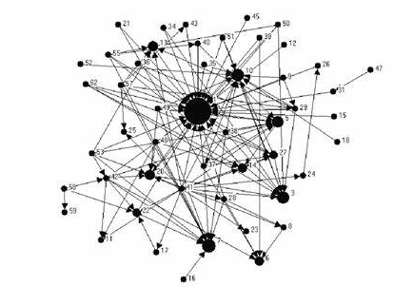
Sources
Warrants
Claims
Are there identifiable features of students’ citation practices that we can use as insights for our teaching?
Notes:
Moore, Spencer & Shiell, Alan & Hawe, Penelope & Haines, Valerie. (2005). The Privileging of Communitarian Ideas: Citation Practices and the Translation of Social Capital Into Public Health Research. American Journal of Public Health. 95. 1330-7. 10.2105/AJPH.2004.046094.

Slide 2
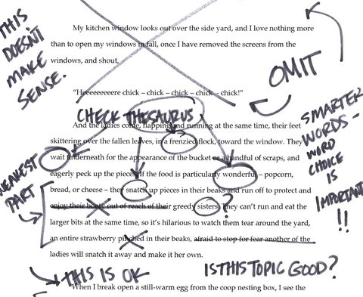
The data I used
Noisy!
Complex
Closed
Inconsistent
Incomplete
Notes:
UG dissertation, part 1
Specialised but …
Selection – marked before I knew I was to use them
Similar standard
Closed source
Ethics – practitioner research

Slide 3
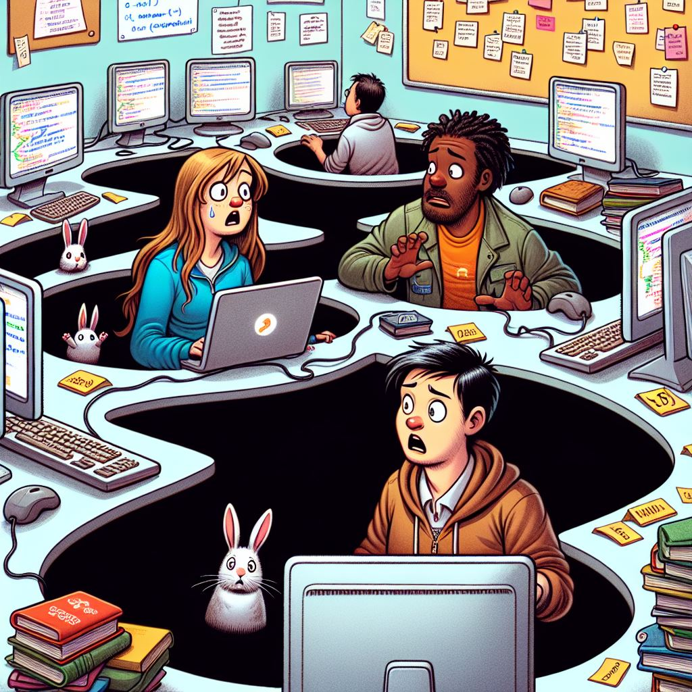
Rabbit holes I ‘investigated’
Scripts: Ruby – anystyle.io
APIs: Openalex.org, Semanticscholar
Commercial: Connectedpapers.com
Packages: Networkx, PyAlex, Litstudy

Slide 4
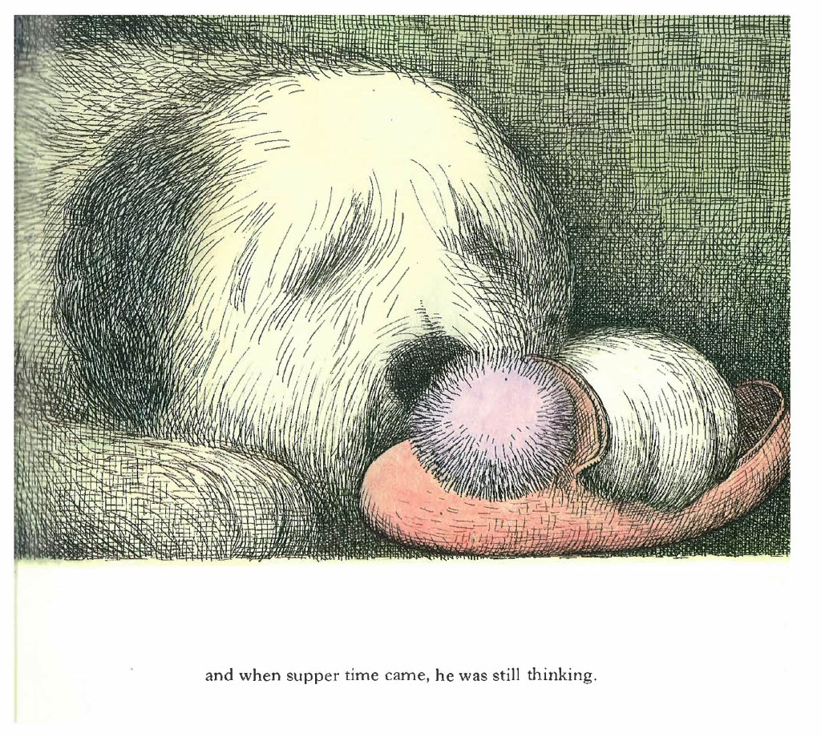

Slide 5
import pandas as pd
import json
import requests
from pyalex import Works
# Assuming excellent_df is already loaded as a pandas DataFrame
# Initialize dictionaries to store OpenAlex IDs and their referenced_by and cited_by IDs
referenced_by_dict = {}
cited_by_dict = {}
test_referenced_by_dict = {}
test_cited_by_dict = {}
# Iterate over each OpenAlex ID in the DataFrame
for openalex_id in excellent_df['id']:
# Lookup information on openalex.org using pyalex library
work = Works(openalex_id).get()
# Extract 'referenced_works' OpenAlex IDs
if 'referenced_works' in work:
referenced_by_dict[openalex_id] = work['referenced_works']
# Extract 'cited_by_api_url' OpenAlex IDs
if 'cited_by_api_url' in work:
cited_by_api_url = work['cited_by_api_url']
response = requests.get(cited_by_api_url)
if response.status_code == 200:
cited_by_work = response.json()
if 'results' in cited_by_work:
cited_by_dict[openalex_id] = [cited['id'] for cited in cited_by_work['results’]]
[…]
# TODO: combine above for loops into a more abstracted function
# Print the dictionaries of OpenAlex IDs and their referenced_by and cited_by IDs
print("Referenced by dictionary:", test_referenced_by_dict)
print("Cited by dictionary:", test_cited_by_dict)

Slide 6
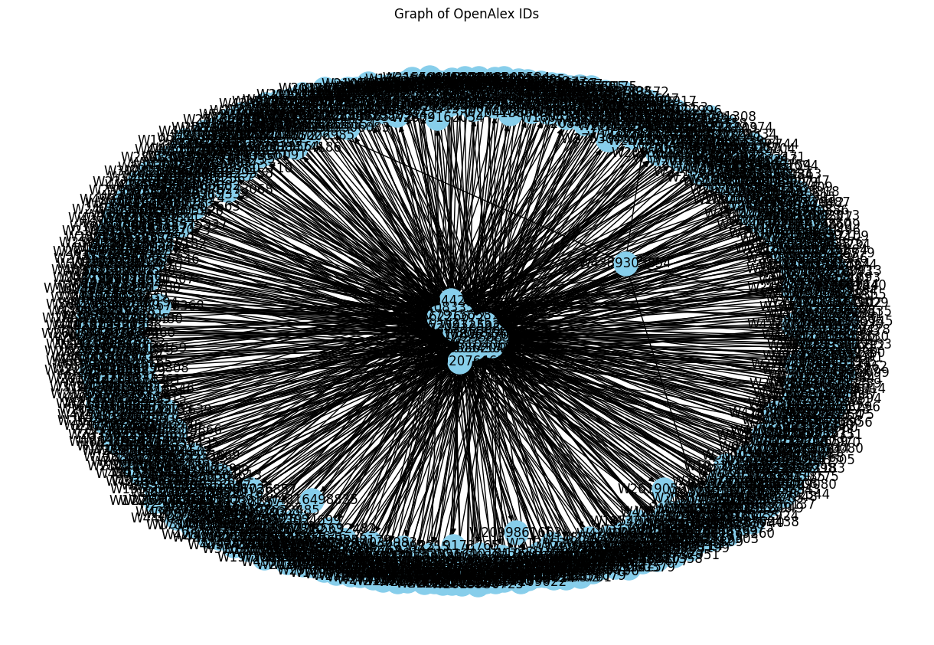
The ‘Eye of Sauron’ graph: utterly unusable!

Slide 7
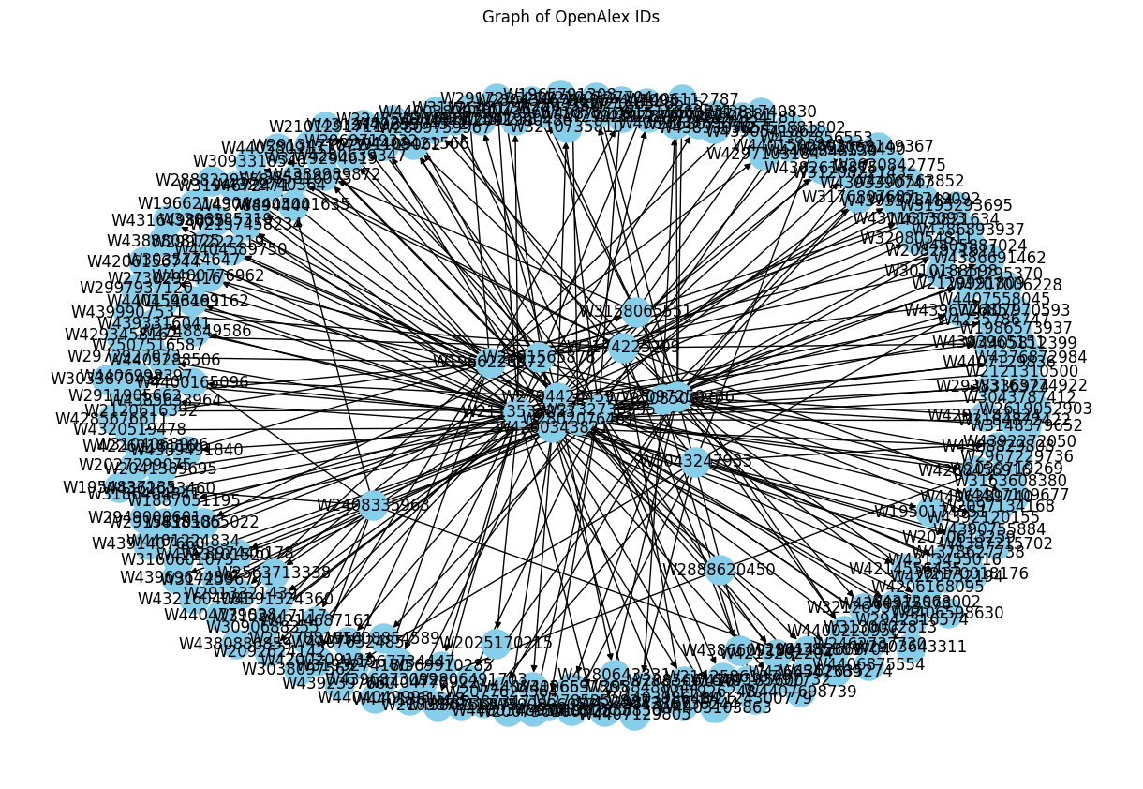
Excellent: directed

Slide 8
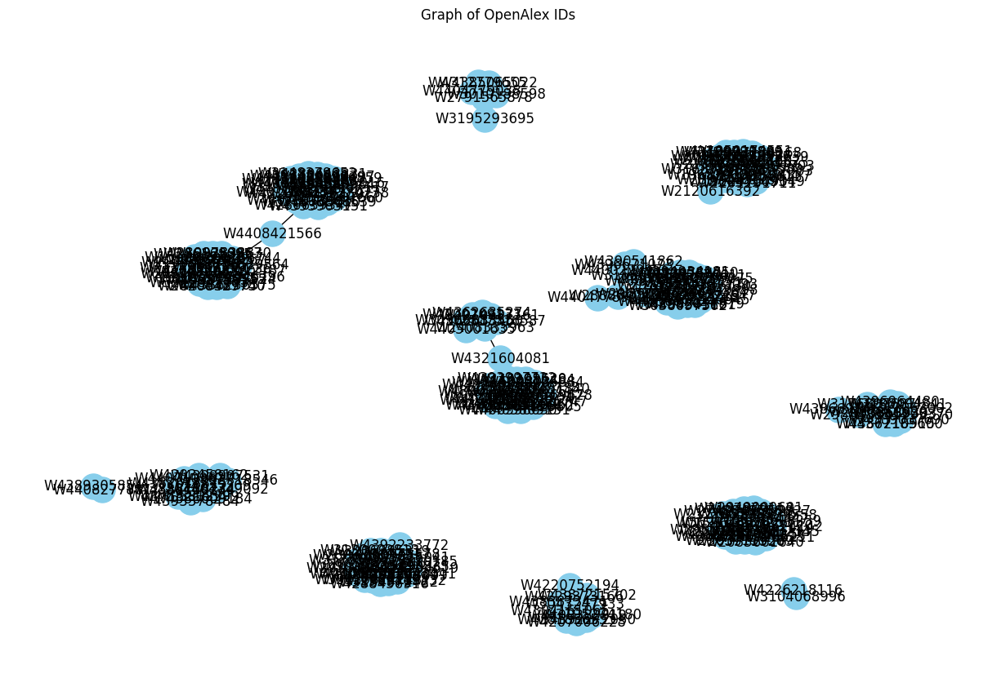
Excellent: undirected

Slide 9
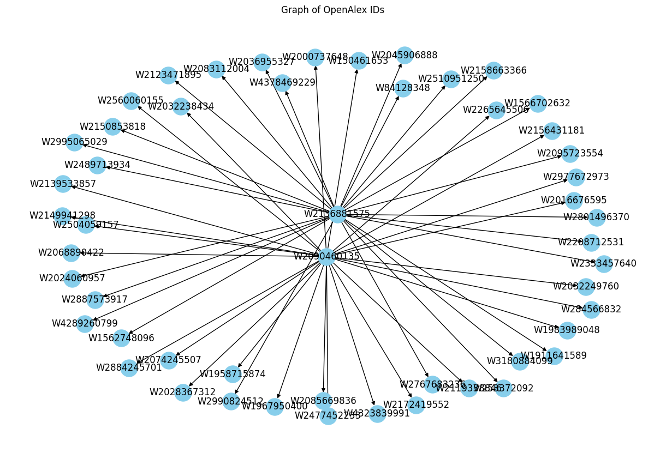
Average: directed

Slide 10
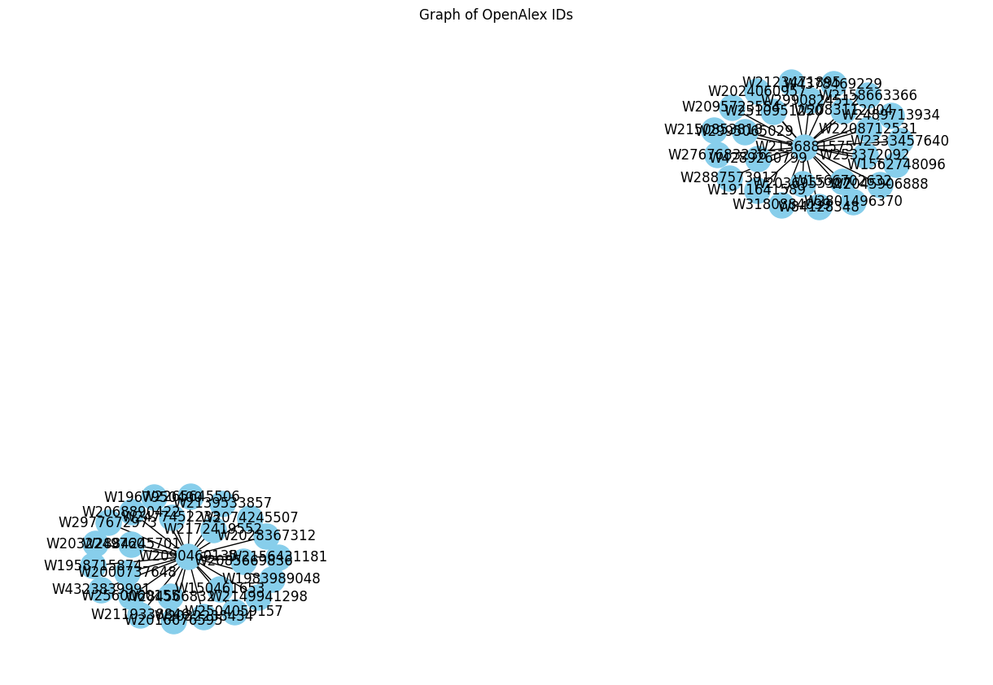
Average: undirected

Slide 11
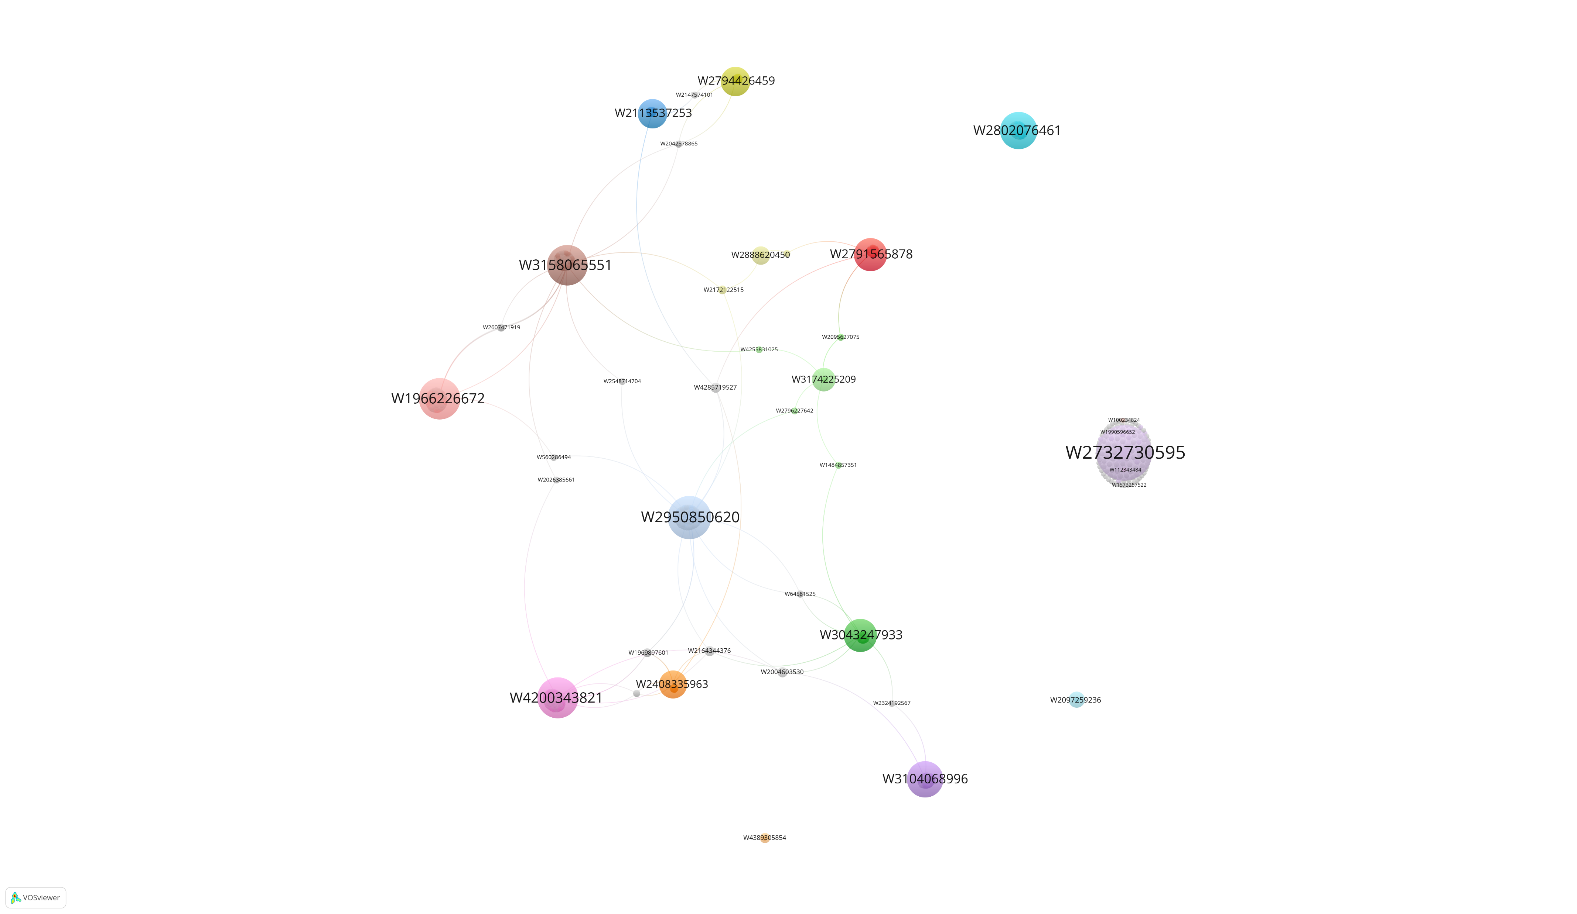
This is my summary
Are there identifiable features of students’ citation practices that we can use as insights for our teaching?
And here is a nice chart to illustrate it
https://github.com/darrengarside/DAML_FinalProject

